Slide 1
Text Data: Flattening, Filtering, and Chunking

Slide 2
Example
Emma knocked on the door. No answer. She knocked again and waited. There was a large maple tree next to the house. Emma looked up the tree and saw a giant raven perched at the treetop. Under the afternoon sun, the raven gleamed magnificently. Its beak was hard and pointed, its claws sharp and strong. It looked regal and imposing. It reigned the tree it stood on. The raven was looking straight at Emma with its beady black eyes. Emma felt slightly intimidated. She took a step back from the door and tentatively said, “Hello?”

Slide 3
Bag-of-X: Turning Natural Text into Flat Vectors
Whether constructing machine learning models or engineering features, it’s nice when the result is simple and interpretable.
Simple things are easy to try, and interpretable features and models are easier to debug than complex ones.
Simple and interpretable features do not always lead to the most accurate model
but it’s a good idea to start simple and only add complexity when absolutely necessary.

Slide 4
Bag-of-X: Turning Natural Text into Flat Vectors
For text data, we can start with a list of word count statistics called a bag-of-words.
A list of word counts makes no special effort to find the interesting entities, such as Emma or the raven.
But those two words are repeatedly mentioned in our sample paragraph, and they have a higher count than a random word like “hello.”
For simple tasks such as classifying a document, word count statistics often suffice.
This technique can also be used in information retrieval, where the goal is to retrieve the set of documents that are relevant to an input text query.

Slide 5
Bag-of-Words
In bag-of-words (BoW) featurization, a text document is converted into a vector of counts.
A vector is just a collection of n numbers.
The vector contains an entry for every possible word in the vocabulary.
If the word—say, “aardvark”—appears three times in the document
The feature vector has a count of 3 in the position corresponding to that word.
If a word in the vocabulary doesn’t appear in the document, then it gets a count of 0.

Slide 6
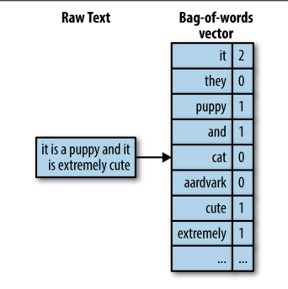
Bag-of-Words “it is a puppy and it is extremely cute”

Slide 7
Bag-of-Words
Bag-of-words converts a text document into a flat vector.
It is “flat” because it doesn’t contain any of the original textual structures.
Neither does bag-of-words represent any concept of word hierarchy.
For example, the concept of “animal” includes “dog,” “cat,” “raven,” etc. But in a bag-of-words representation, these words are all equal elements of the vector.

Slide 8
Bag-of-Words
Important here is the geometry of data in feature space.
In a bag-of-words vector, each word becomes a dimension of the vector.
If there are n words in the vocabulary, then a document becomes a point1 in n-dimensional space.
It is difficult to visualize the geometry of anything beyond two or three dimensions, so we will have to use our imagination.

Slide 9
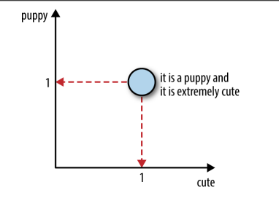
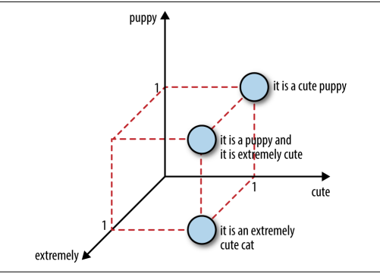
Bag-of-Words 2D and 3D

Slide 10
Bag-of-Words
Bag-of-words is not perfect.
Breaking down a sentence into single words can destroy the semantic meaning.
For instance, “not bad” semantically means “decent” or even “good”.
But “not” and “bad” constitute a floating negation plus a negative sentiment.

Slide 11
Bag-of-n-Grams
Bag-of-n-Grams, or bag-of-n-grams, is a natural extension of bag-of-words.
An n-gram is a sequence of n tokens.
A word is essentially a 1-gram, also known as a unigram.
After tokenization, the counting mechanism can collate individual tokens into word counts, or count overlapping sequences as n-grams.
For example, the sentence “Emma knocked on the door” generates the n-grams “Emma knocked,” “knocked on,” “on the,” and “the door.”

Slide 12
Bag-of-n-Grams
the bag-of-n-grams representation can be more informative.
However, this comes at a cost.
Theoretically, with k unique words, there could be k² unique 2-grams (also called bigrams).
In practice, there are not nearly so many, because not every word can follow every other word.

Slide 13
Bag-of-n-Grams
To illustrate how the number of n-grams grows with increasing n
let’s compute n-grams on the Yelp reviews dataset.
In Example 3-1, we compute the n-grams of the first 10,000 reviews using Pandas and the Count Vectorizer trans former in scikit-learn.

Slide 14
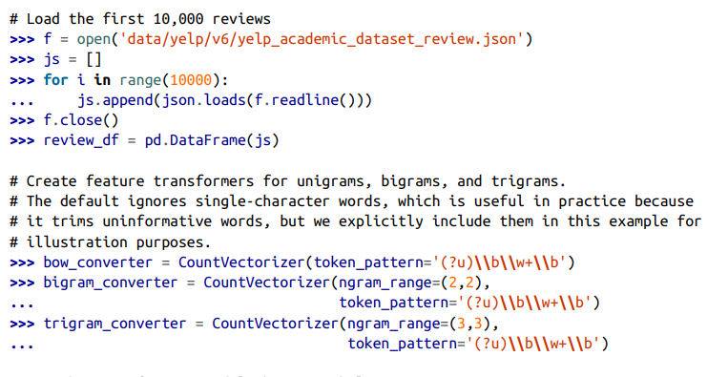
Bag-of-n-Grams

Slide 15
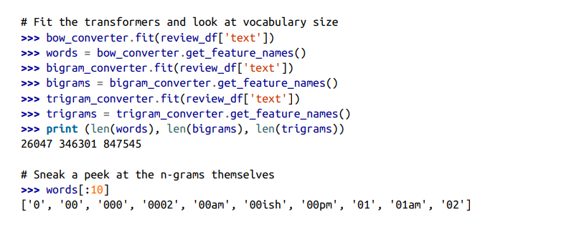
Bag-of-n-Grams

Slide 16
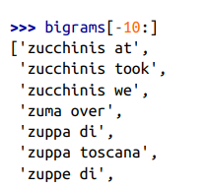
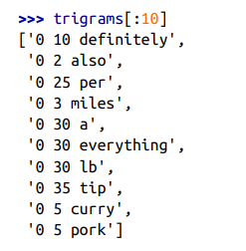

Bag-of-n-Grams

Slide 17
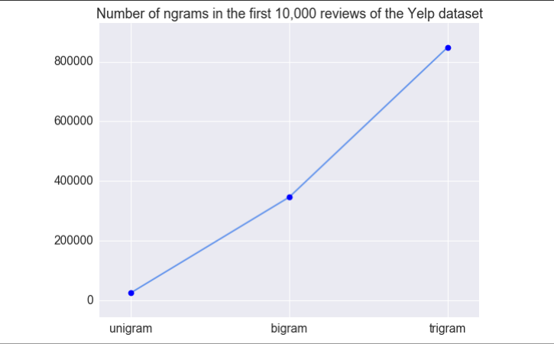
Bag-of-n-Grams

Slide 18
Filtering for Cleaner Features
With words, how do we cleanly separate the signal from the noise?
filtering techniques that use raw tokenization and counting to generate lists of simple words or n-grams become more usable.
Here are a few more ways to perform filtering.

Slide 19
Stopwords
Classification and retrieval do not usually require an in-depth understanding of the text.
For instance, in the sentence “Emma knocked on the door,” the words “on” and “the” don’t change the fact that this sentence is about a person and a door.
For coarse-grained tasks such as classification, the pronouns, articles, and prepositions may not add much value.
The case may be very different in sentiment analysis, which requires a fine-grained understanding of semantics.

Slide 20
Stopwords
The popular Python NLP package NLTK contains a linguist-defined stopword list for many languages.
(You will need to install NLTK and run nltk.download() to get all the goodies.) Various stopword lists can also be found on the web.
For instance, here are some sample words from the English stopword list: a, about, above, am, an, been, didn't, couldn't, i'd, i'll, itself, let's, myself, our, they, through, when's, whom, ...

Slide 21
Frequency-Based Filtering
Stopword lists are a way of weeding out common words that make for vacuous features.
There are other, more statistical ways of getting at the concept of “common words.”
In collocation extraction, we see methods that depend on manual definitions, and those that use statistics.
The same idea applies to word filtering.

Slide 22
Frequent words
Frequency statistics are great for filtering out corpus-specific common words as well as general-purpose stopwords.
For instance, the phrase “New York Times” and each of the individual words in it appear frequently in the New York Times Annotated Corpus dataset.
Similarly, the word “house” appears often in the phrase “House of Commons” in the Hansard corpus of Canadian parliament debates
These words are meaningful in general, but not within those particular corpora.
A typical stopword list will catch the general stopwords, but not corpus-specific ones.

Slide 23
Frequent words
Looking at the most frequent words can reveal parsing problems and highlight normally useful words that happen to appear too many times in the corpus.
For example, Table in next slide lists the 40 most frequent words in the Yelp reviews dataset.
Here, frequency is based on the number of documents (reviews) they appear in, not their count within a document.

Slide 24
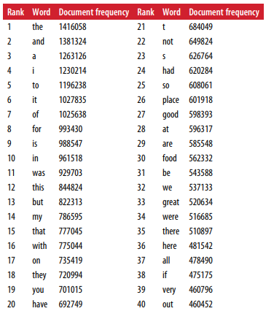
Frequent words

Slide 25
Frequent words
It contains some surprises. “s” and “t” are on the list because we used the apostrophe as a tokenization delimiter, and words such as “Mary’s” or “didn’t” got parsed as “Mary s” and “didn t.”
Furthermore, the words “good,” “food,” and “great” each appear in around a third of the reviews
but we might want to keep them around because they are very useful for tasks such as sentiment analysis or business categorization

Slide 26
Rare words
Depending on the task, one might also need to filter out rare words.
These might be truly obscure words, or misspellings of common words.
To a statistical model, a word that appears in only one or two documents is more like noise than useful information.
For example, suppose the task is to categorize businesses based on their Yelp reviews, and a single review contains the word “rareoneatonomy”
How would one tell, based on this one word, whether the business is a restaurant or a salon?

Slide 27
Rare words
Not only are rare words unreliable as predictors, they also generate computational overhead.
The set of 1.6 million Yelp reviews contains 357,481 unique words (tokenized by space and punctuation characters)
189,915 of which appear in only one review, and 41,162 in two reviews.
Over 60% of the vocabulary occurs rarely.
This is a so-called heavy-tailed distribution, and it is very common in real-world data.

Slide 28
Rare words
The training time of many statistical machine learning models scales linearly with the number of features
some models are quadratic or worse.
Rare words incur a large computation and storage cost for not much additional gain
Rare words can be easily identified and trimmed based on word count statistics.
Alternatively, their counts can be aggregated into a special garbage bin, which can serve as an additional feature.

Slide 29
Rare words
The rare words lose their identity and get grouped into a garbage bin feature
Since one won’t know which words are rare until the whole corpus has been counted
the garbage bin feature will need to be collected as a post-processing step.

Slide 30
Stemming
One problem with simple parsing is that different variations of the same word get counted as separate words.
For instance, “flower” and “flowers” are technically differ‐ ent tokens, and so are “swimmer,” “swimming,” and “swim,”
Even though they are very close in meaning.
It would be nice if all of these different variations got mapped to the same word.
Stemming is an NLP task that tries to chop each word down to its basic linguistic word stem form.

Slide 31
Stemming
There are different approaches. Some are based on linguistic rules, others on observed statistics.
A subclass of algorithms incorporate part-of-speech tagging and linguistic rules in a process known as lemmatization.
Most stemming tools focus on the English language, though efforts are ongoing for other languages.
The Porter stemmer is the most widely used free stemming tool for the English language.
The original program is written in ANSI C, but many other packages have since wrapped it to provide access to other languages.

Slide 32
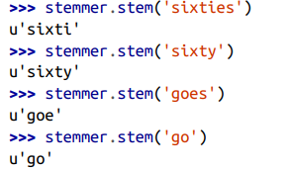
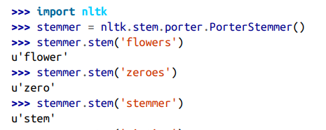
Stemming
Here is an example of running the Porter stemmer through the NLTK Python package.
As you can see, it handles a large number of cases, but it’s not perfect. The word “goes” is mapped to “goe,” while “go” is mapped to itself:

Slide 33
Stemming
Stemming does have a computation cost.
Whether the end benefit outweighs the cost is application-dependent.
It is also worth noting that stemming could hurt more than it helps.
The words “new” and “news” have very different meanings, but both would be stemmed to “new.”
For this reason, stemming is not always used

Slide 34
Atoms of Meaning: From Words to n-Grams to Phrases
The concept of bag-of-words is straightforward.
But how does a computer know what a word is?
A text document is represented digitally as a string, which is basically a sequence of characters.
One might also run into semi-structured text in the form of JSON blobs or HTML pages.
But even with the added tags and structure, the basic unit is still a string.
How does one turn a string into a sequence of words? This involves the tasks of parsing and tokenization.

Slide 35
Parsing and Tokenization
Parsing is necessary when the string contains more than plain text.
For instance, if the raw data is a web page, an email, or a log of some sort, then it contains additional structure.
One needs to decide how to handle the markup, the headers and footers, or the uninteresting sections of the log.
If the document is a web page, then the parser needs to handle URLs.
If it is an email, then fields like From, To, and Subject may require special handling
otherwise these headers will end up as normal words in the final count, which may not be useful.

Slide 36
Parsing and Tokenization
After light parsing, the plain-text portion of the document can go through tokenization.
This turns the string—a sequence of characters—into a sequence of tokens.
Each token can then be counted as a word.
The tokenizer needs to know what characters indicate that one token has ended and another is beginning.
Space characters are usually good separators, as are punctuation characters.
If the text contains tweets, then hash marks (#) should not be used as separators (also known as delimiters).

Slide 37
Collocation Extraction for Phrase Detection
A collocation is an expression consisting of two or more words that correspond to some conventional way of saying things.
Collocations are more meaningful than the sum of their parts.
For instance, “strong tea” has a different meaning beyond “great physical strength” and “tea”; therefore, it is considered a collocation.
The phrase “cute puppy,” on the other hand, means exactly the sum of its parts: “cute” and “puppy.” Thus, it is not considered a colloca‐ tion.

Slide 38
Collocations do not have to be consecutive sequences.
For example, the sentence “Emma knocked on the door” is considered to contain the collocation “knock door.”
Hence, not every collocation is an n-gram.
Conversely, not every n-gram is deemed a meaningful collocation.
Collocations are useful as features. But how does one discover and extract them from text?
One way is to predefine them.

Slide 39
If we tried really hard, we could probably find comprehensive lists of idioms in various languages, and we could look through the text for any matches.
It would be very expensive, but it would work.
If the corpus is very domain specific and contains esoteric lingo, then this might be the preferred method.
But the list would require a lot of manual curation, and it would need to be constantly updated for evolving corpora.
For example, it probably wouldn’t be very realistic for analyzing tweets, or for blogs and articles.

Slide 40
Since the advent of statistical NLP in the last two decades, people have opted more and more for statistical methods for finding phrases.
Instead of establishing a fixed list of phrases and idiomatic sayings, statistical collocation extraction methods rely on the ever-evolving data to reveal the popular sayings of the day.

Slide 41
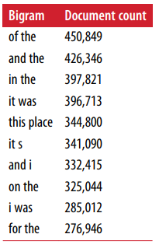
Frequency-based methods
A simple hack is to look at the most frequently occurring n-grams.
The problem with this approach is that the most frequently occurring ones may not be the most useful ones.
Table 3-2 shows the most popular bigrams (n = 2) in the entire Yelp reviews dataset.
As we can see, the top 10 most frequently occurring bigrams by document count are very generic terms that don’t contain much meaning.

Slide 42
Hypothesis testing for collocation extraction
Raw popularity count is too crude of a measure.
We have to find more clever statistics to be able to pick out meaningful phrases easily.
The key idea is to ask whether two words appear together more often than they would by chance.
The statistical machinery for answering this question is called a hypothesis test.

Slide 43
Hypothesis testing for collocation extraction
Hypothesis testing is a way to boil noisy data down to “yes” or “no” answers.
It involves modeling the data as samples drawn from random distributions.
The randomness means that one can never be 100% sure about the answer
there’s always the chance of an outlier. So, the answers are attached to a probability

Slide 44
Hypothesis testing for collocation extraction
In the context of collocation extraction, many hypothesis tests have been proposed over the years.
One of the most successful methods is based on the likelihood ratio test (Dunning, 1993).
For a given pair of words, the method tests two hypotheses on the observed dataset.
Hypothesis 1 (the null hypothesis) says that word 1 appears independently from word 2.
Another way of saying this is that seeing word 1 has no bearing on whether we also see word 2.
Hypothesis 2 (the alternate hypothesis) says that seeing word 1 changes the likelihood of seeing word 2.

Slide 45
Hypothesis testing for collocation extraction
We take the alternate hypothesis to imply that the two words form a common phrase.
Hence, the likelihood ratio test for phrase detection (a.k.a. collocation extraction) asks the following question:
are the observed word occurrences in a given text corpus more likely to have been generated from a model
where the two words occur independently from one another
or a model where the probabilities of the two words are entangled?

Slide 46
Chunking and part-of-speech tagging

